Slide 1
Session #28: Environmental Impact of Self-Supervised Models
Thursday, October 18
CSCI 601.771: Self-supervised Statistical Models

Slide 2
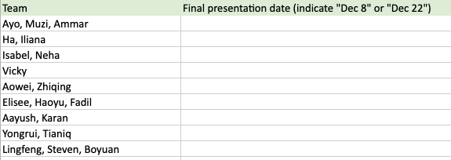
See my message from two days ago.

Slide 3
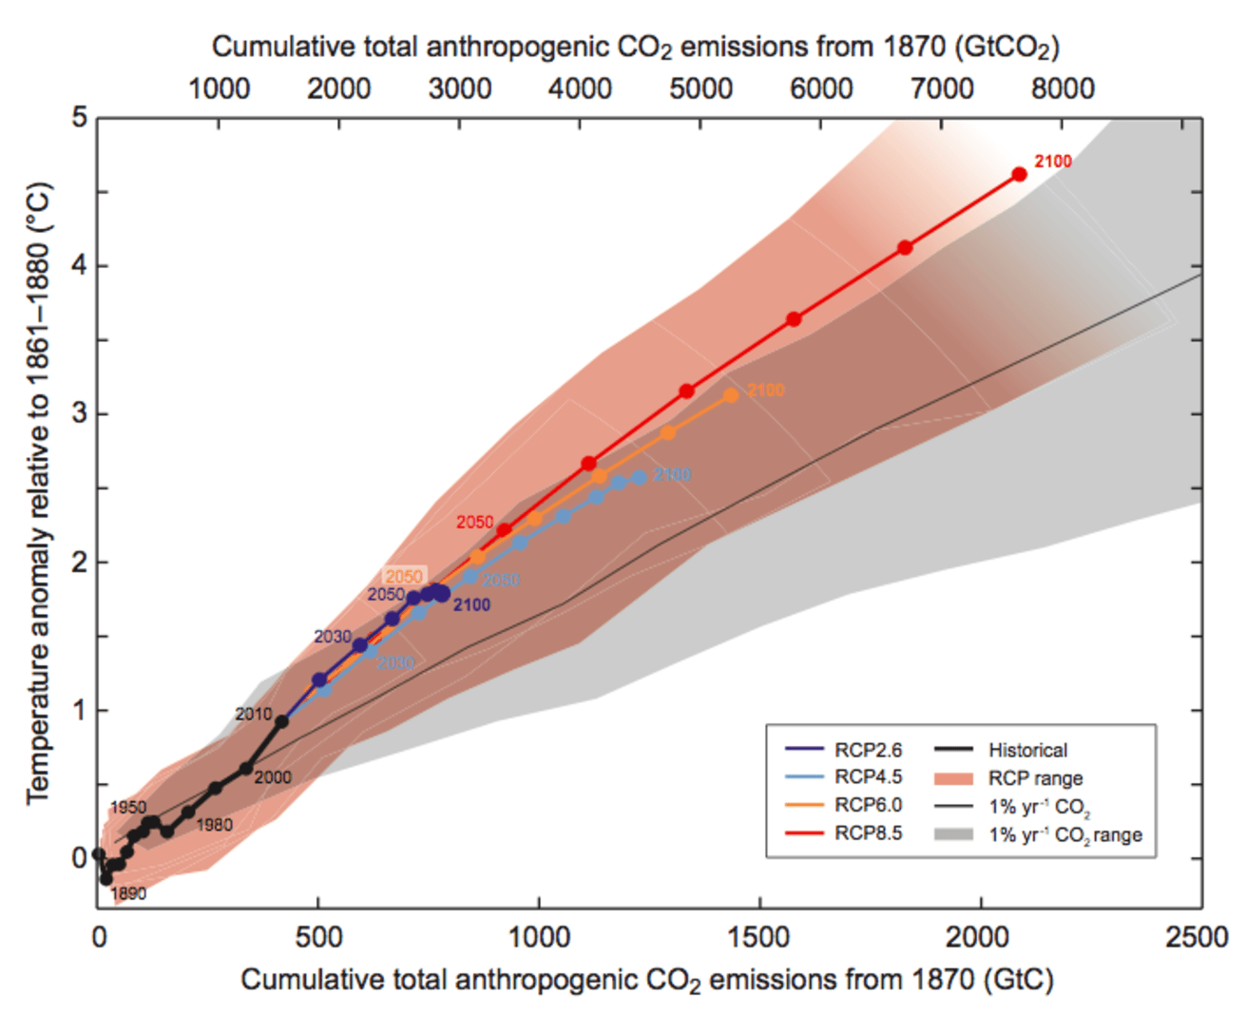

Slide 4
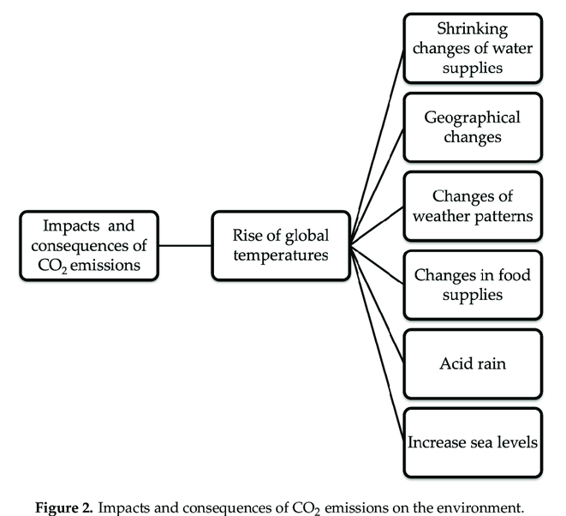
Ahmed Ali et al. "Issues, impacts, and mitigations of carbon dioxide emissions in the building sector." Sustainability 12.18 (2020): 7427.

Slide 5
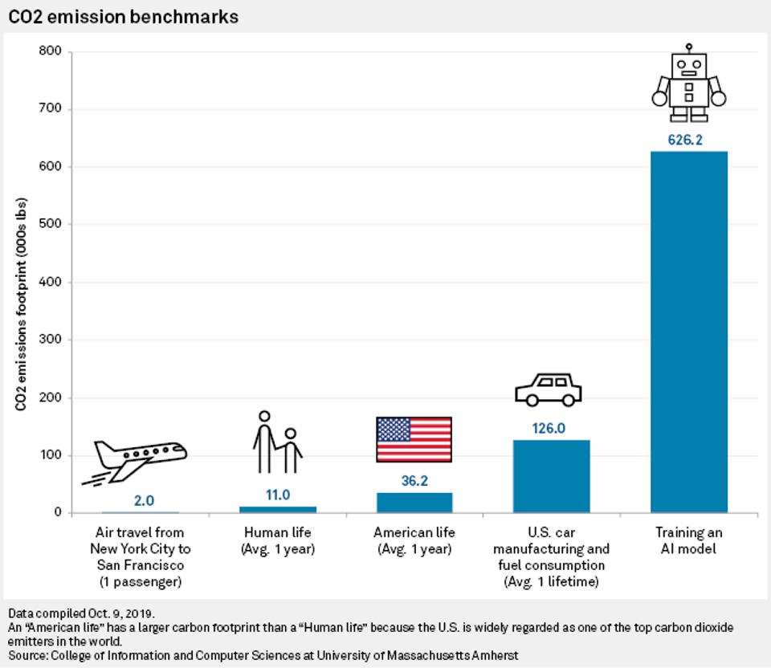

Slide 6
Stakeholders
Ammar, Fadil, Karan

Slide 7
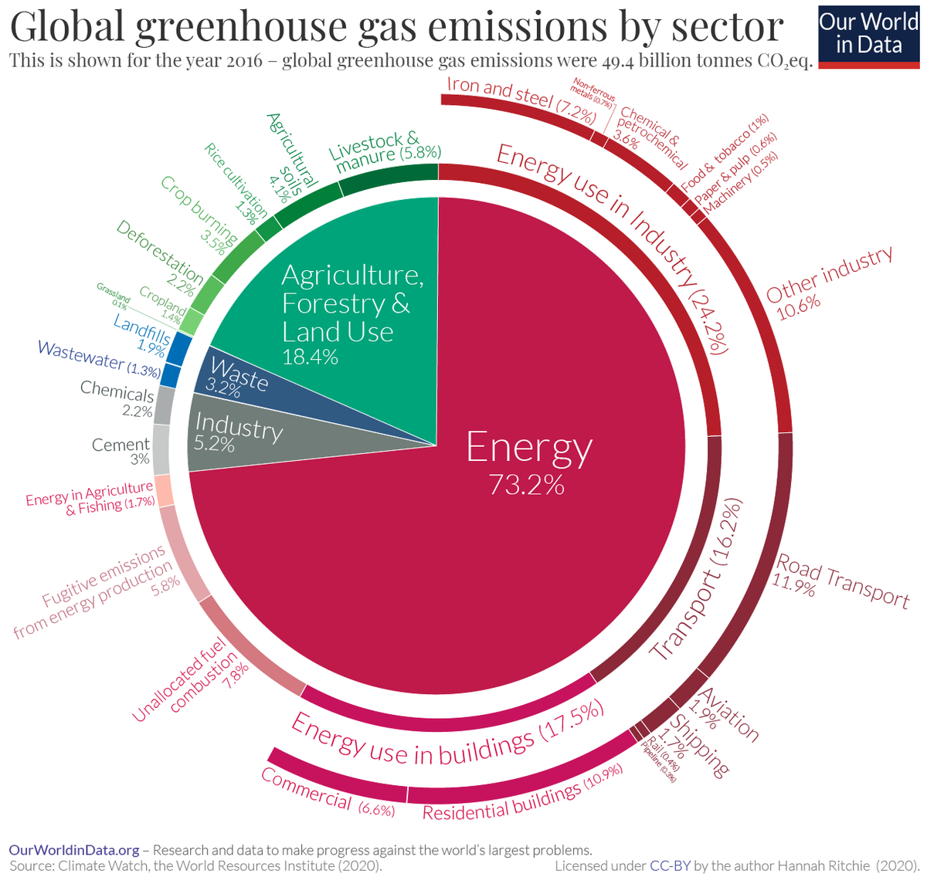
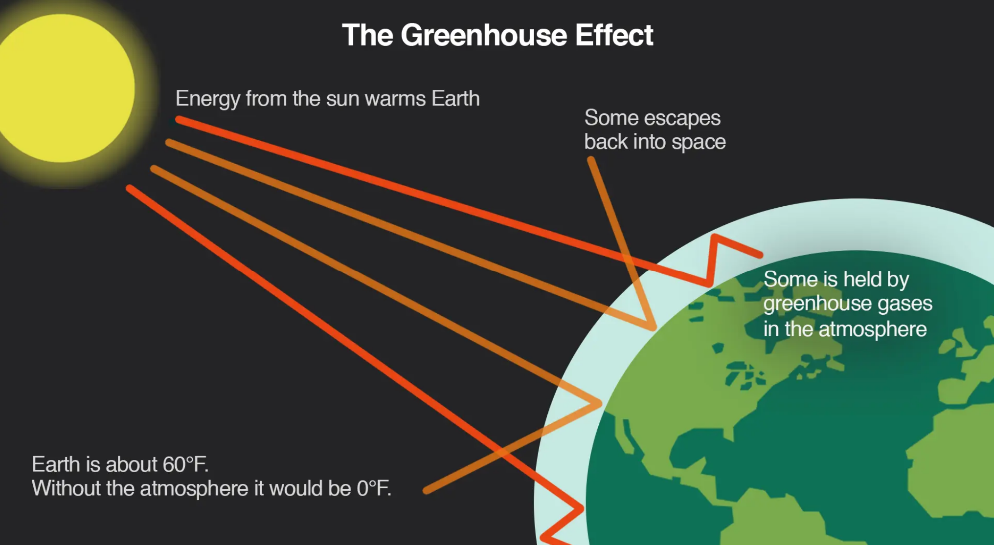
BACKGROUND
CO2 (and other types of greenhouse gases, such as methane and ozone)contributes to the greenhouse effect by trapping the heat from the sun within the atmosphere without letting it dissipate.
https://www.climatecentral.org/climate-matters/the-greenhouse-effect

Slide 8
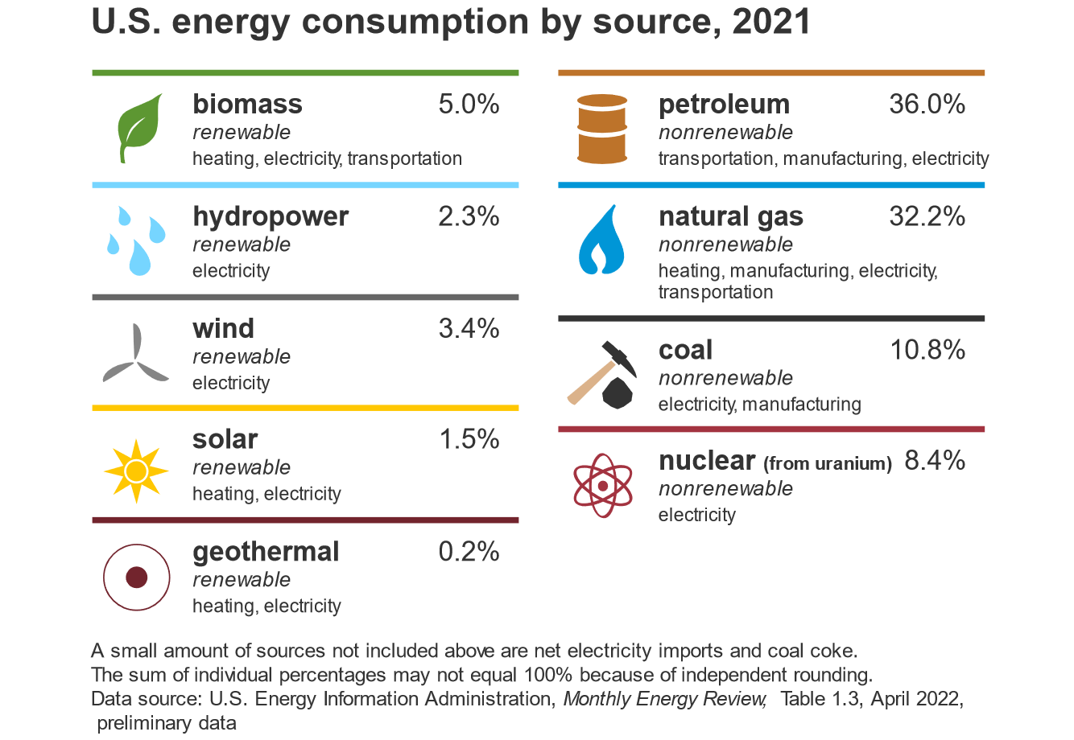
BACKGROUND
US Energy Information Administration

Slide 9
BACKGROUND
In 2018, it was estimated that global data center energy use represented close to 1% of global energy usage
 | Electricity net consumption (billion kWh)
World | 22,027
Portugal | 49
Hong Kong | 45
Denmark | 34
Morocco | 31
New Zealand | 40
US Energy Information Administration: 2018 Electricity consumption by country

Slide 10
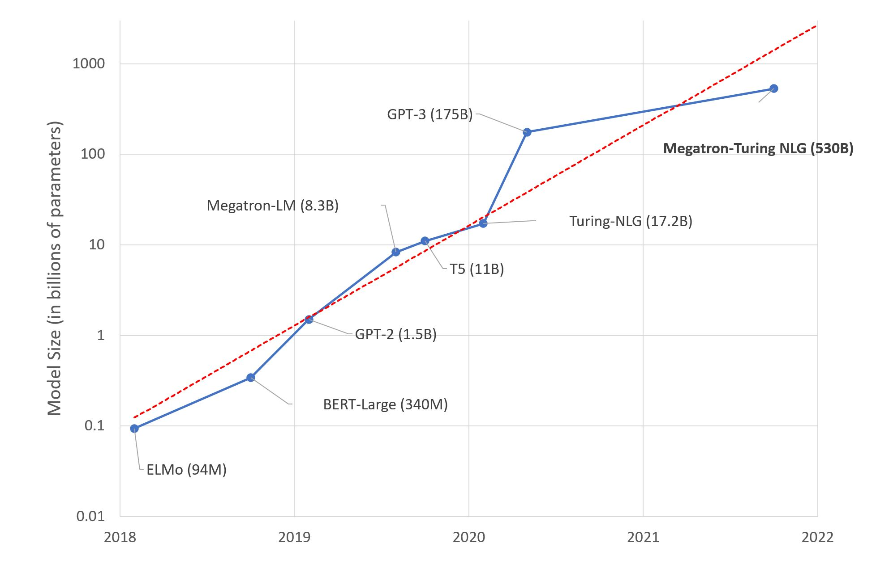
BACKGROUND
Model Size growing exponentially!!
Strubell et al showed Transformer training emissions comparable to 5 cars!!
And it will take 1200 trees to get rid of the emissions!!!

Slide 11
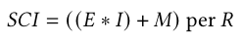
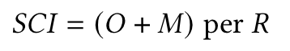
COMPUTING CO2 INTENSITY
Energy (E) consumed by a software (KWh)
Software Carbon Intensity(SCI) = carbon emissions per one functional unit R
R = one machine learning job
Operational Emission (O) [used in the article]
Location based marginal carbon emission (gCO2eq/KWh)
Carbon emission by hardware [ignored in the article]

Slide 12
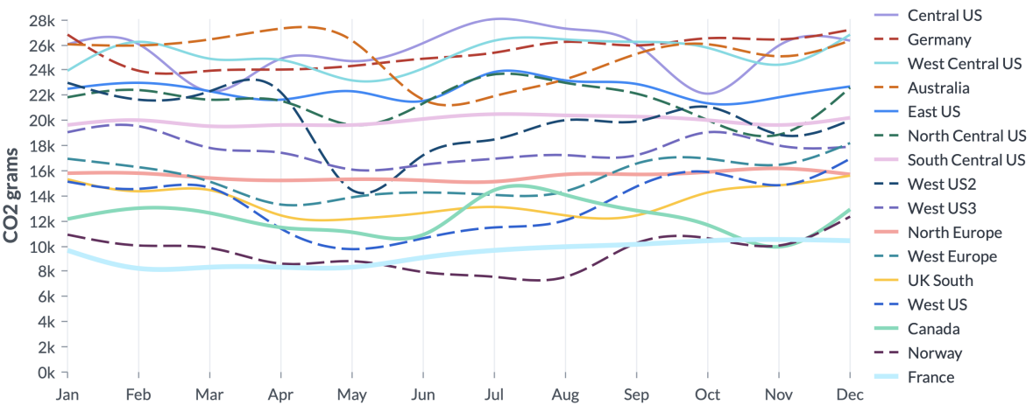
EMISSIONS BY REGION
Each region has different sources of energy. Higher renewable source implies less carbon emissions.
Training BERT (language modeling on 8 V100s for 36 hours).
Each line is relatively flat.
Large variation between the least carbon-intensive regions compared to the most carbon-intensive regions.

Slide 13
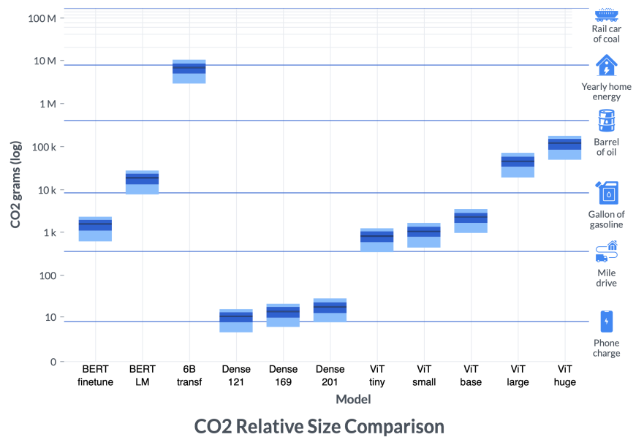
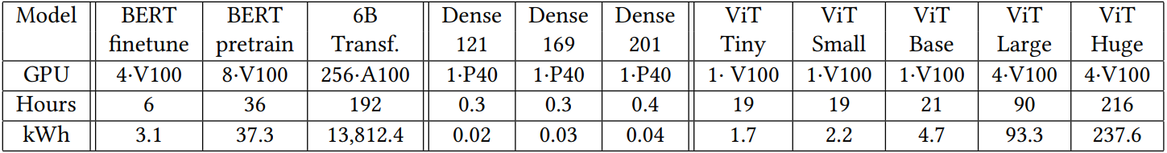
ELECTRICITY CONSUMPTION FOR AI WORKLOADS

Slide 14
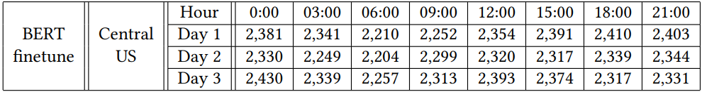
EMISSIONS BY TIME OF DAY
The emissions vary by time of day because during the day, a region may have a higher mix of renewable energy or fossil-fuel based source.
The amount of variation varies by region and time of year
Finetuning the BERT-small model on a standard natural language inference task for around 6 hours on 4 NVIDIA V100 GPUs

Slide 15
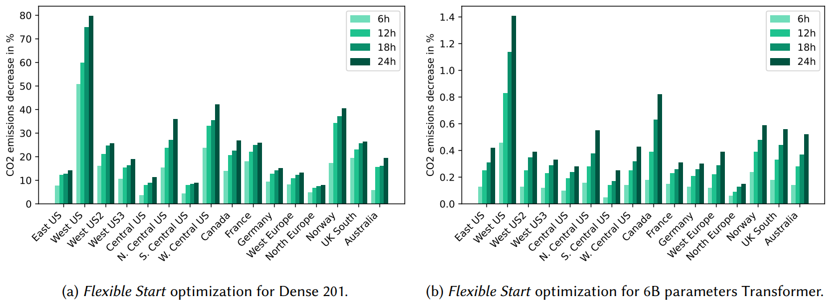
OPTIMIZING CLOUD WORKLOADS
Flexible Start
Proportion of emissions we expect to save if we change the start time by up to 24 hours.

Slide 16
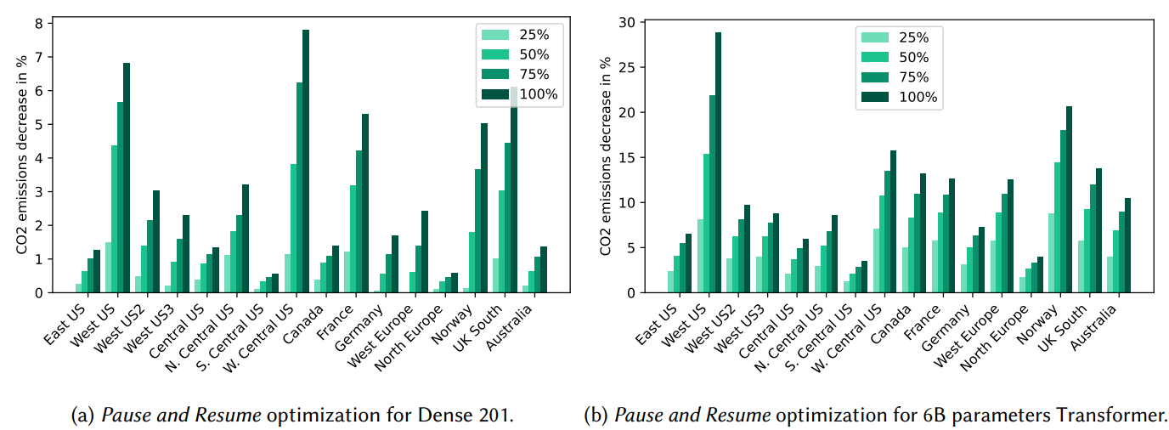
OPTIMIZING CLOUD WORKLOADS
Pause and Resume
Proportion of emissions we expect to save if we use "Pause and Resume" for a duration up to double the original duration.

Slide 17
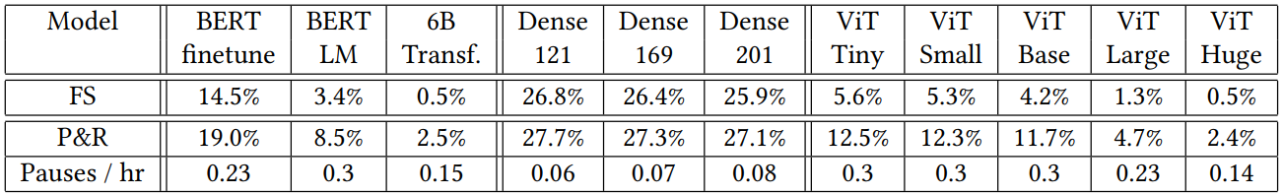
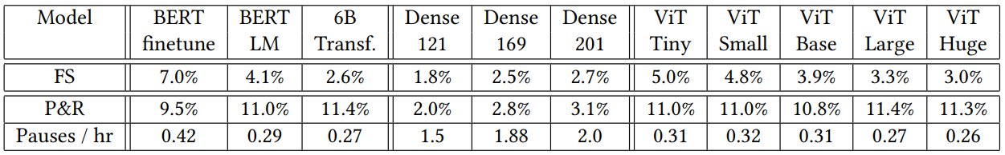
OPTIMIZING CLOUD WORKLOADS
Comparison of the Two Methods
Duration increased by 24 hours (top); duration increased by 100% (bottom).
Allowed the same increase in duration, Pausing and Resuming (P&R) will always be better than Flexible Start (FS).

Slide 18

CONSIDERATIONS FOR MODEL DEVELOPMENT AND DEPLOYMENT
How can informed decisions help reduce emissions? (some examples)
Running job at a specific time and region to reduce emissions
If (Region A = ↑ Cost & ↓ Emission _____________Vs Region B = ↓ Cost & ↑Emission):
Then Run Job in Region B and use the remaining
amount to reduce emissions.

Slide 19

FUTURE DIRECTIONS
Scopes of emissions.
Developing certification systems for “Green AI”.
Improving the carbon transparency of research and practice.
Supporting improved estimates of emissions rates.
Reducing AI’s scope-enabled emissions.

Slide 20
TBD
TBD
👩🏽‍🔬: TBD

Slide 21
TBD
TBD
🔎: TBD

Slide 22
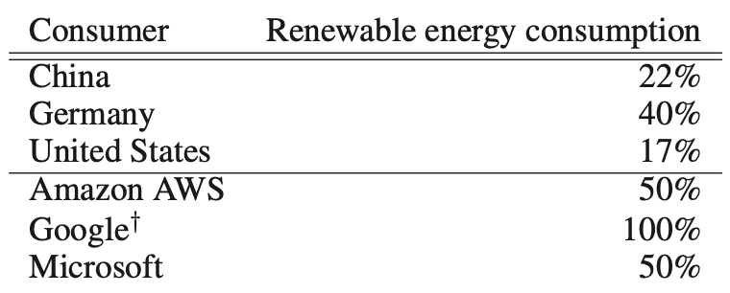
Visionary
Energy and Policy Considerations for Modern Deep Learning Research (2020 AAAI)
report training time and sensitivity to hyperparameters
equitable access to computation resources
prioritize computationally efficient hardware and algorithms
mindful of energy sources powering their compute
Not all cloud services provide equally sustainable compute resource
Not possible for all region to source renewable energy
Possible to conduct research about relationship between energy sources and energy usage
Quantifying the Carbon Emissions of Machine Learning (2019 NeurIPS Workshop)
🔭: Haoyue Guan, Boyuan Zheng

Slide 23
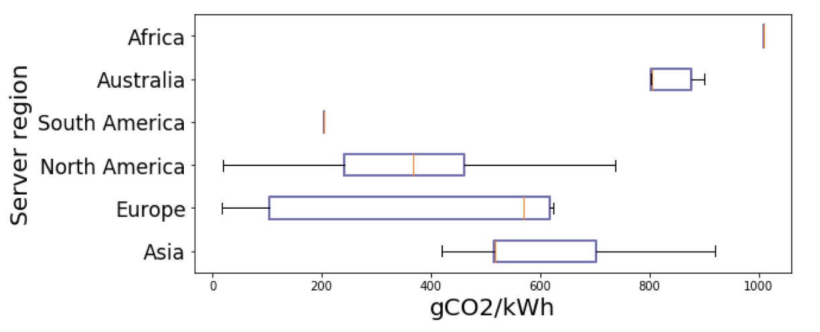
Quantifying the Carbon Emissions of Machine Learning (2019 NeurIPS Workshop)
illustrate the degree of variability that exists
depending on the location of a given server
Sampled from known GPU server locations from the three major cloud providers: Google Cloud Platform, Microsoft Azure and Amazon Web Services
Based on pure estimation
ML Emissions Calculator https://mlco2.github
🔭: Haoyue Guan, Boyuan Zheng

Slide 24
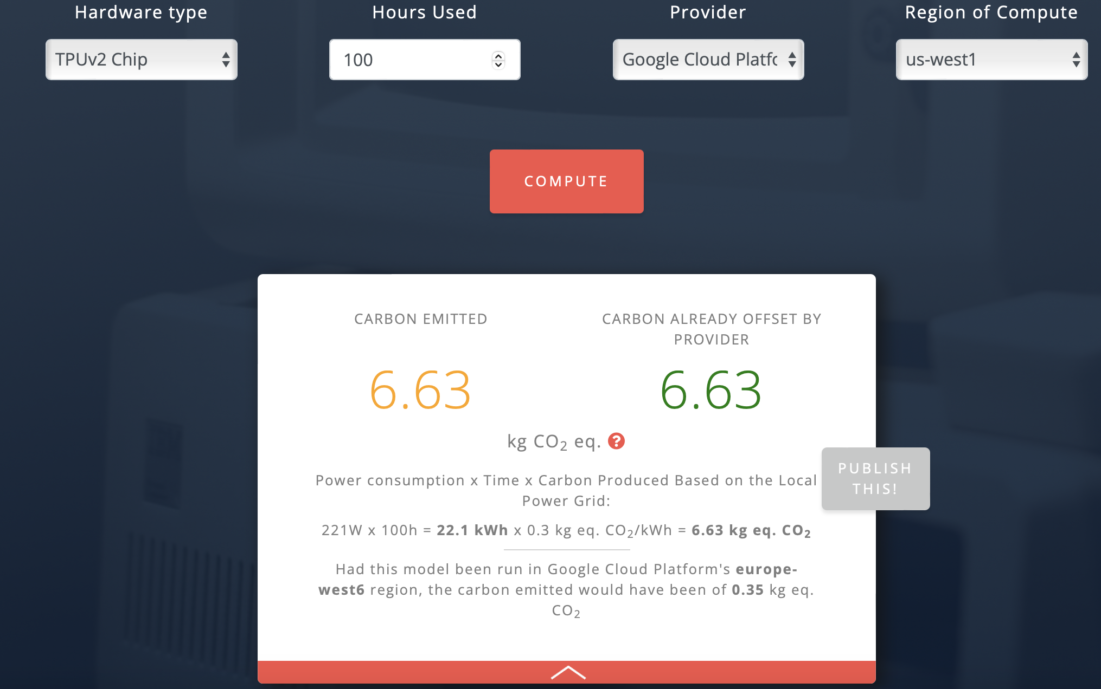
🔭: Haoyue Guan, Boyuan Zheng

Slide 25
Attract More Attention from Researcher
Question: Training BERT-base -> How much CO2? -> What does this means?
Problem:
Lack of Visibility
Where can I know Carbon footprint?
What these numbers mean?
How to interpret CO2 weight?
🔭: Haoyue Guan, Boyuan Zheng

Slide 26
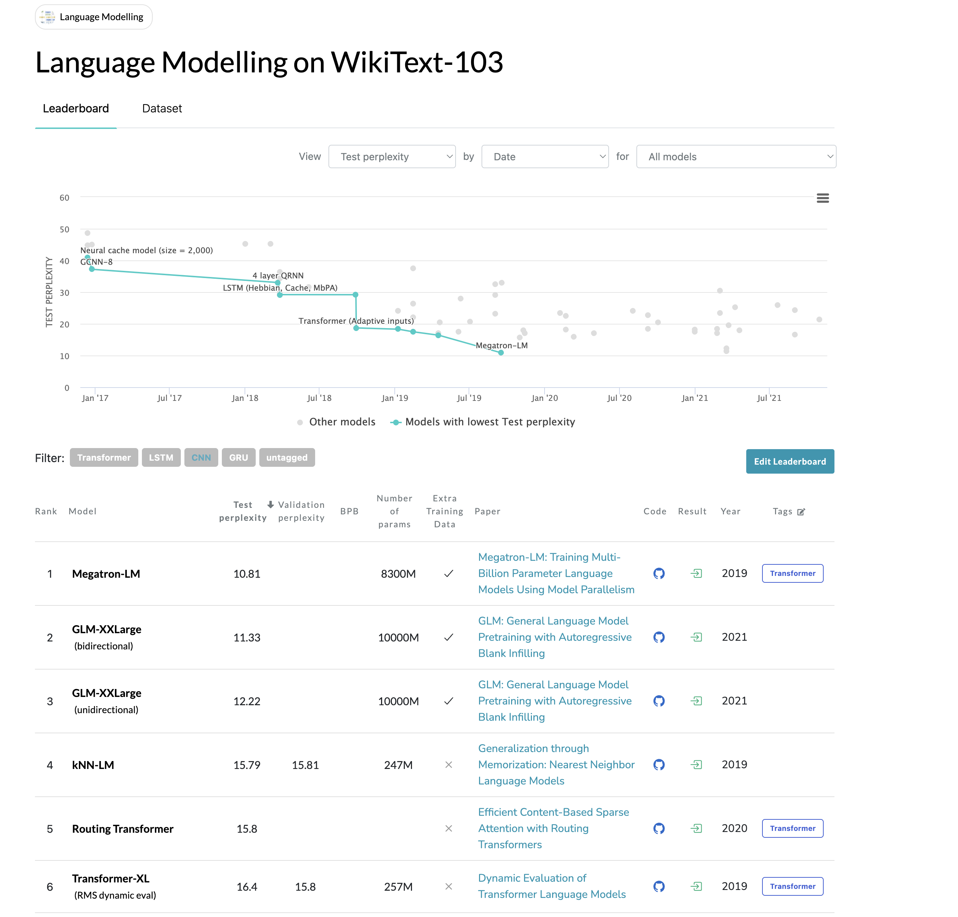

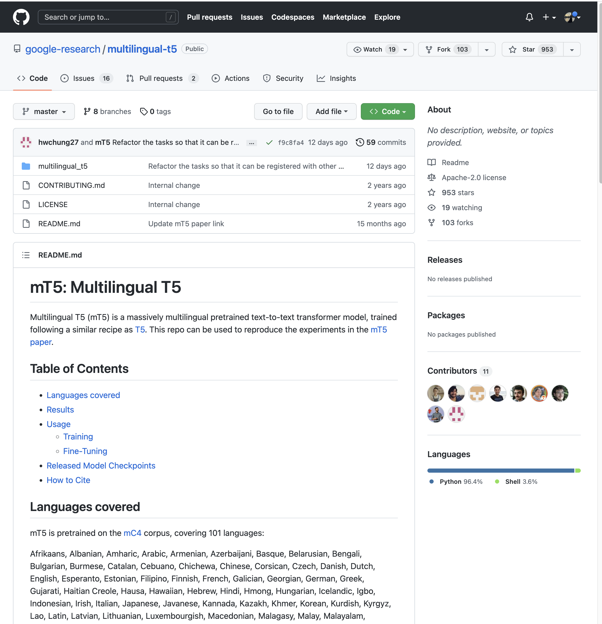

Visible Carbon Footprint
Put to somewhere more noticeable:
PaperwithCode
Huggingface
Github
🔭: Haoyue Guan, Boyuan Zheng

Slide 27



Carbon Comparison for ML Community
Find something comparable:
How to interpret Calories in Diet?
Drive car for an hour, etc.
🔭: Haoyue Guan, Boyuan Zheng

Slide 28
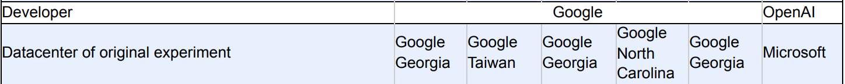
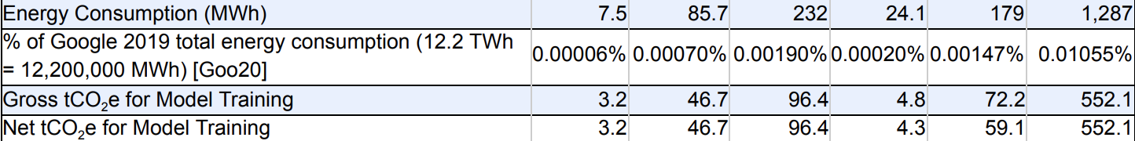
Visionary
More accurate estimation/quantification technique on carbon emissions for deep learning tasks
Possible way to estimate the power/carbon emission of TPUs
Carbon Emissions and Large Neural Network Training (https://arxiv.org/abs/2104.10350)
🔭: Haoyue Guan, Boyuan Zheng

Slide 29
Empiricist
“Measuring the Carbon Intensity of AI in Cloud Instances” doesn’t publish code yet
Try CodeCarbon, a python package framework to calculate emissions
Two versions: offline (own server) and online (cloud)
CO2 emissions = C*P ,
where:
C = Carbon Intensity of the electricity consumed for computation (kgCO₂/kWh)
P = Power Consumed by the computational infrastructure (kWh)
Experiment: Test CO2 emission of a python program on a JHU server
Input: A python program
Output: The CO2 emissions from the process
👩🏽‍🔬: Ha Bui

Slide 30
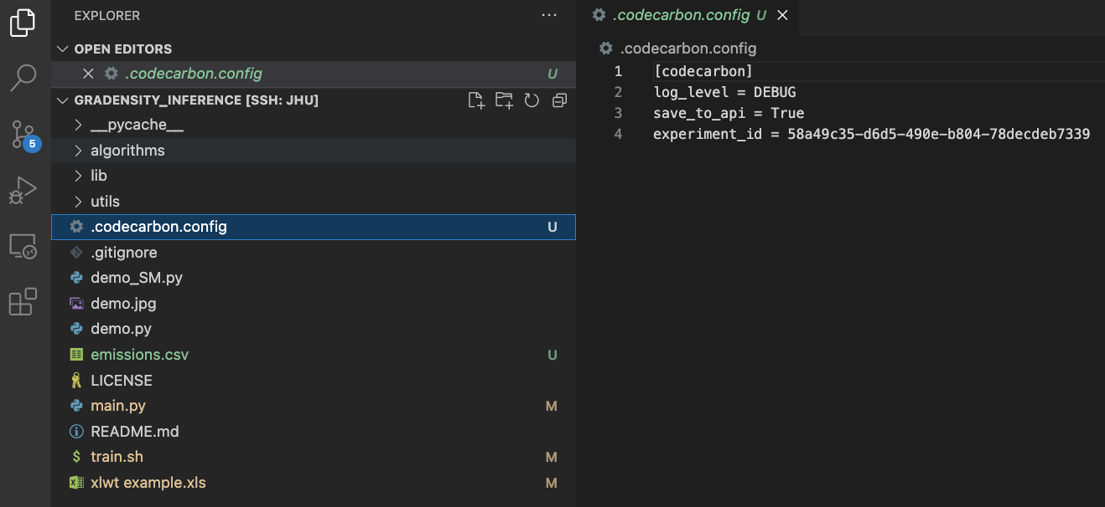
Installation and configuration
Installation:
!conda install -c conda-forge codecarbon
Configuration:
Create “experiment_id”: !codecarbon init
This id will be used to send results to codecarbon database
👩🏽‍🔬: Ha Bui

Slide 31
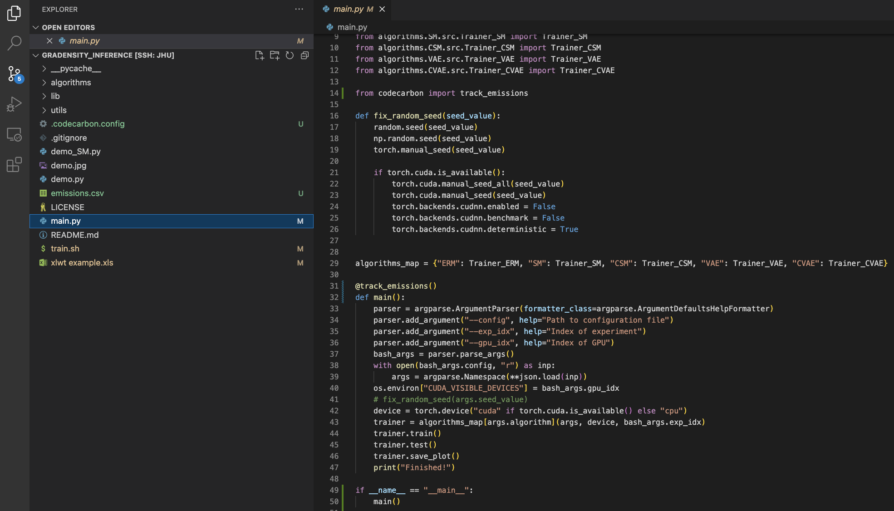
Installation and configuration
Configuration:
Create “experiment_id”: !codecarbon init
Track emission from the code by adding “@track_emissions()” before main function, then run the program as usual
👩🏽‍🔬: Ha Bui

Slide 32
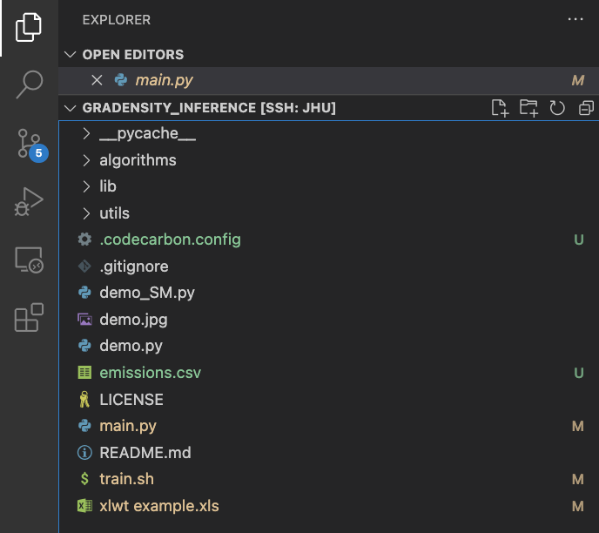
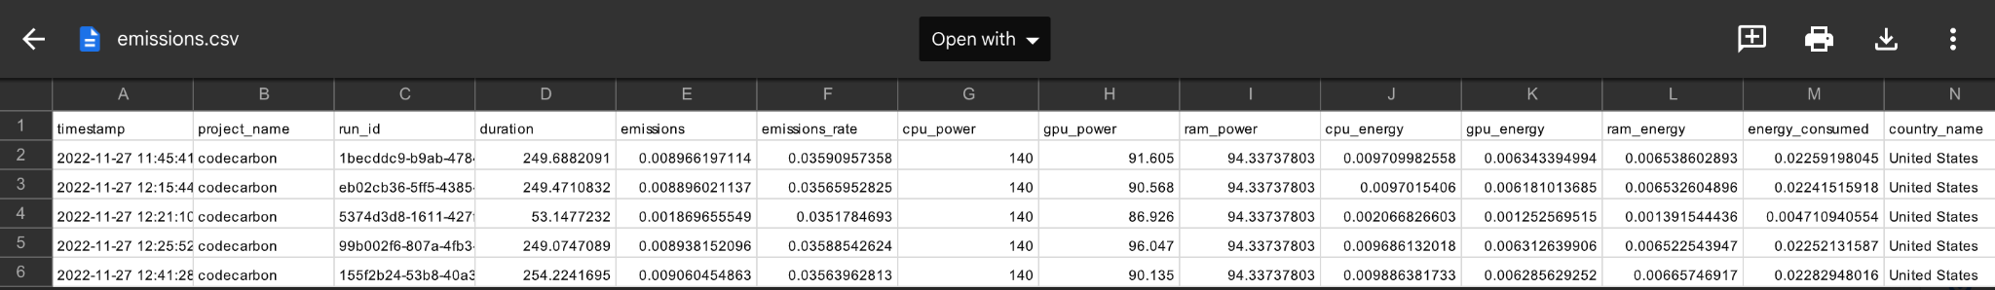
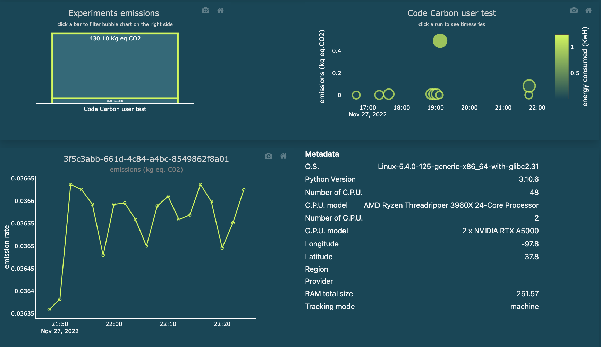
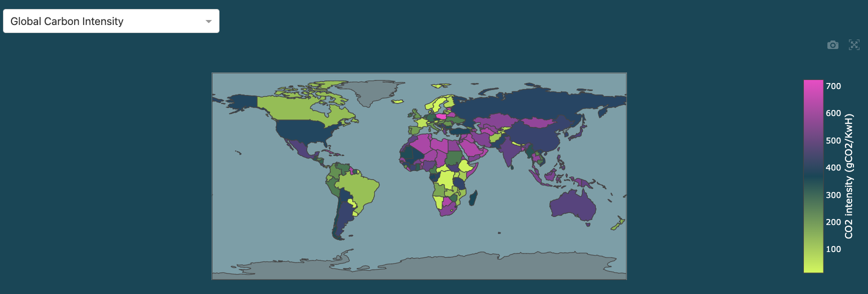
Results
Outputs:
A csv file, contain tracking CO2 emissions info
A visualization of CO2 emissions on https://dashboard.codecarbon.io/
👩🏽‍🔬: Ha Bui

Slide 33
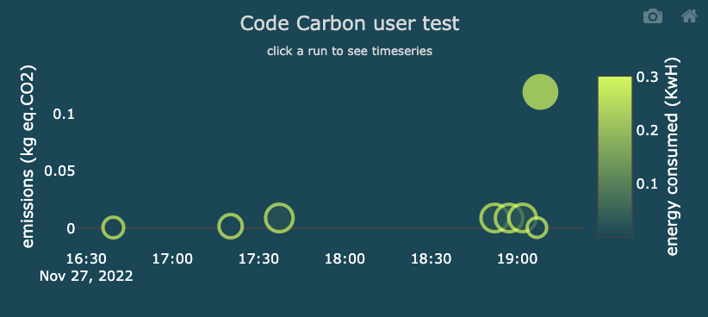
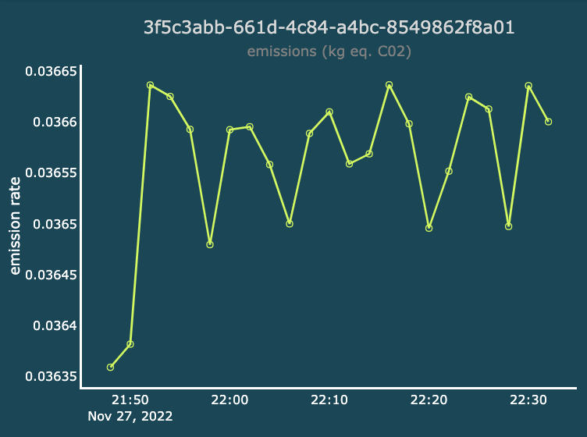
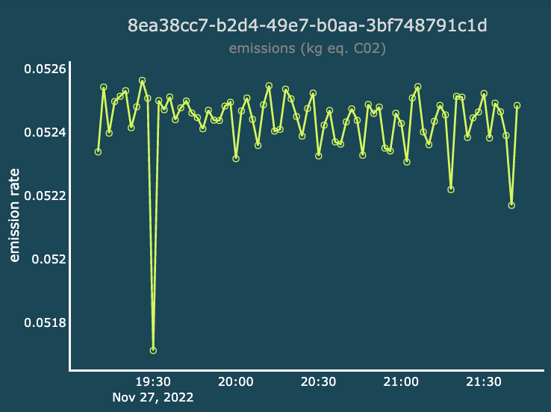
Results: Comparison between backbones
Comparison between Wide ResNet-28-10 and LeNet5
Observation:
Wider ResNet-28-10 is deeper, therefore run longer and cause much higher CO2 emission!
👩🏽‍🔬: Ha Bui

Slide 34
Conclusion
CodeCarbon, a python package framework to calculate emissions
Easy to install and configure
Easy to integrate with our code
Easy to track CO2 emissions
Highly recommend to try if you care about environmental issue!
👩🏽‍🔬: Ha Bui

